Slide 1
Data Binning
By Or Dinar, Liad Ackerman and Maayan Ben Zion
Guided by Dr. Adi Akavia

Slide 2
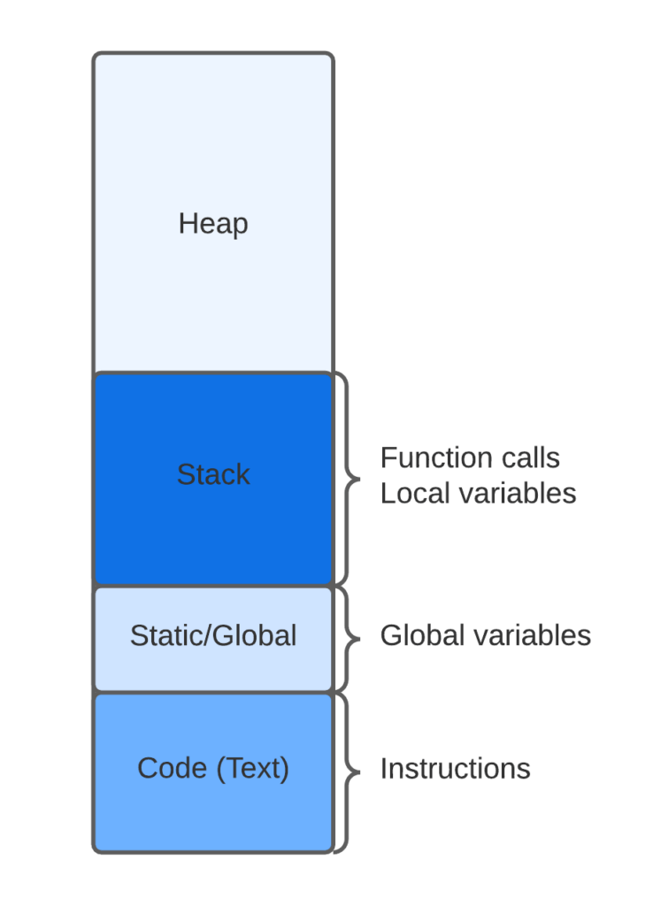

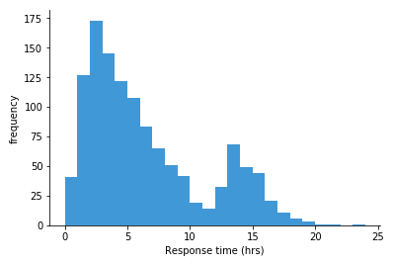
Topics
Balanced Allocation
Cuckoo Hashing
Data Binning

Slide 3
Data Generalization
Data generalisation involves sorting sensitive columns into bins or groups for analysis, removing specifics and creating a more generalised view. This technique, in combination with other pseudonymisation methods, is particularly effective for large datasets.
Balanced Allocation
Cuckoo Hashing
Data Binning

Slide 4
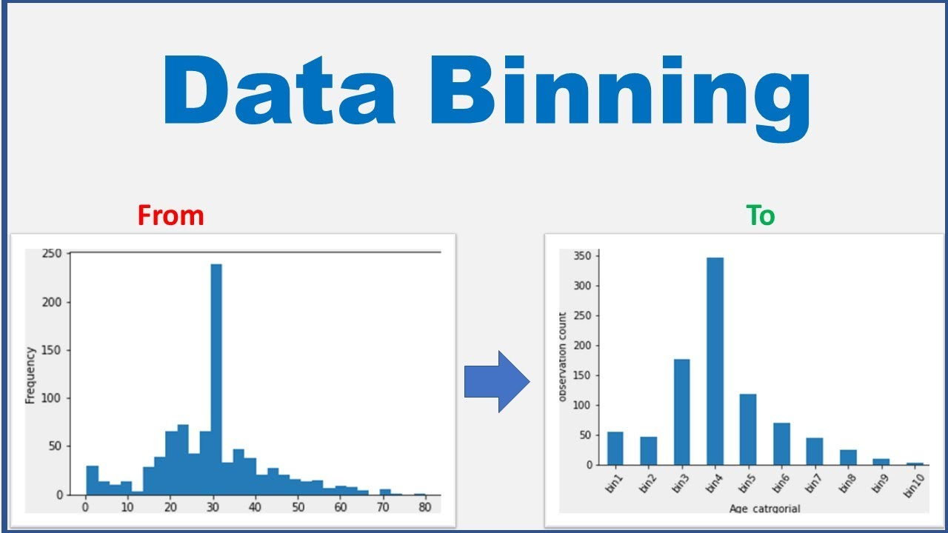
Definition of Data Binning
‘Discretization or “binning” is a common form of data preprocessing, aimed at grouping continuous or numerical values into a smaller number of bins (buckets).
Balanced Allocation
Cuckoo Hashing
Data Binning

Slide 5

Examples of Data Binning
Balanced Allocation
Cuckoo Hashing
Data Binning
Recycling:
Glass
Plastic
Paper
Organic
Metals
Electronic Waste

Slide 6
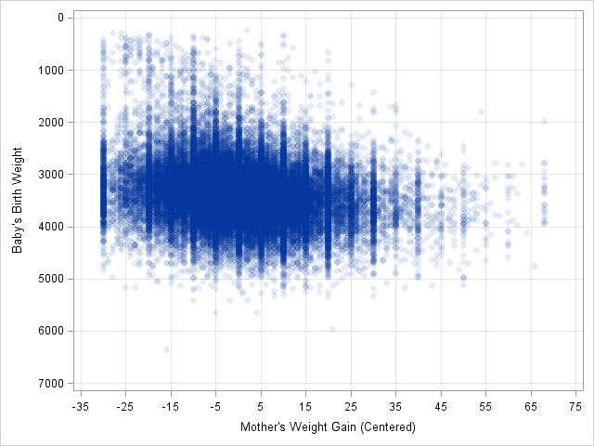
Examples of Data Binning
Balanced Allocation
Cuckoo Hashing
Data Binning
Binning an extensive amount of data into discrete values
in a 2D model

Slide 7
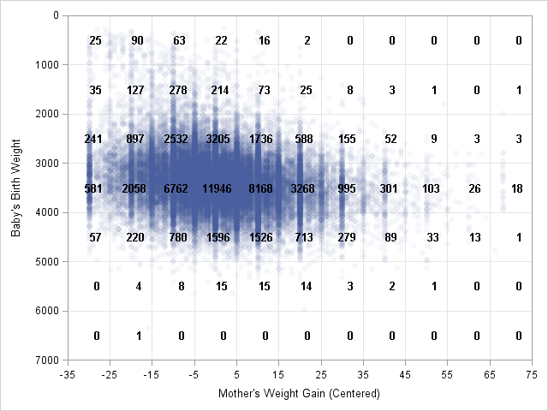
Examples of Data Binning
Balanced Allocation
Cuckoo Hashing
Data Binning
Binning an extensive amount of data into discrete values
in a 2D model

Slide 8
Steps
Balanced Allocation
Cuckoo Hashing
Data Binning
1
Identify the range of all values
2
Choose a suitable Binning method
3
Choose the amount of bins
4
Sort the data in the defined range
5
Analyze the data

Slide 9
Common Binning methods
Balanced Allocation
Cuckoo Hashing
Data Binning
Equal-Width Binning
Equal-Frequency Binning
Entropy-Based Binning
Custom Binning
Quantile Binning
Optimal Binning

Slide 10
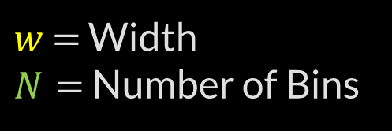
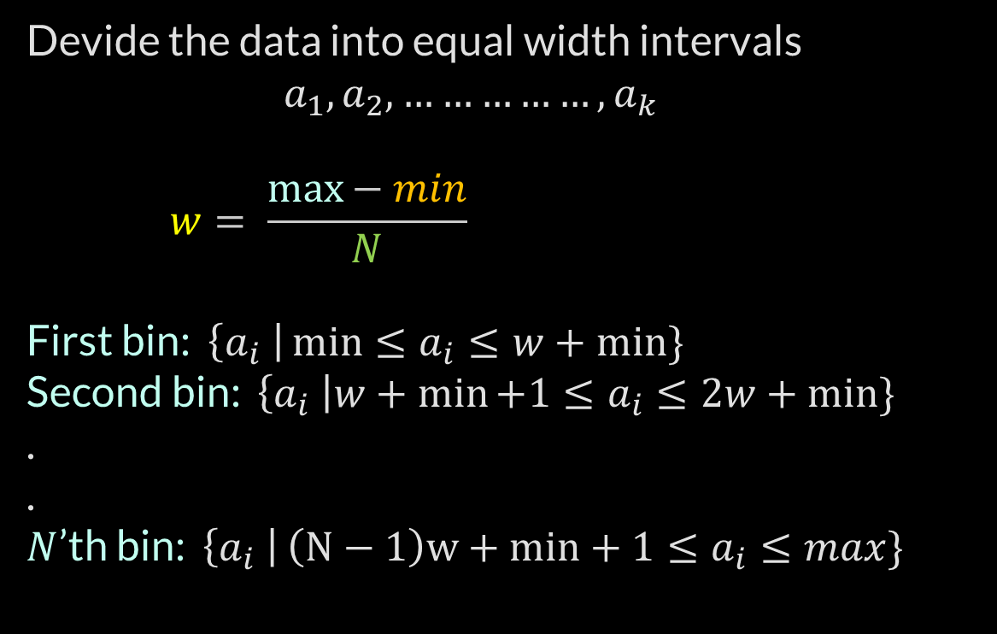
Equal-Width Binning
Balanced Allocation
Cuckoo Hashing
Data Binning
Devide the data into equal width intervals
$$a_{1},a_{2}, ……………,a_{k }$$
$$w= \frac{\max{− min}}{N}$$
First bin: $\left\{a_{i} \right|\min{≤a_{i}≤w+min\}}$
Second bin: $\left\{a_{i} \right|w+\min{+1≤a_{i}≤2w+min\}}$
.
.
$N$’th bin: $\left\{a_{i} \right|\left(N−1\right)w+min+1{≤a_{i}≤max\}}$
$w$ $=$ Width
$N=$ Number of Bins

Slide 11
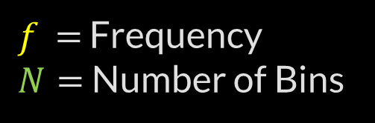
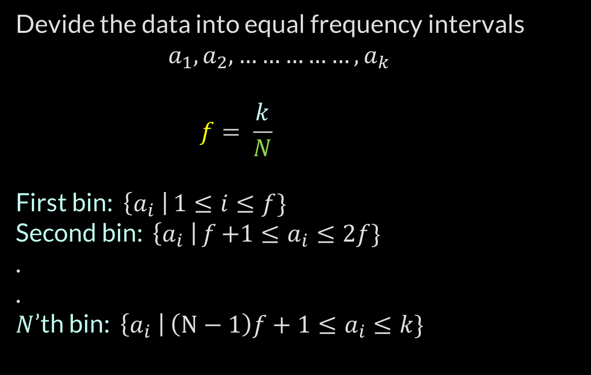
Equal-Frequency Binning
Balanced Allocation
Cuckoo Hashing
Data Binning
Devide the data into equal frequency intervals
$$a_{1},a_{2}, ……………,a_{k }$$
$$f= \frac{k}{N}$$
First bin: $\left\{a_{i} \right|1{≤i≤f\}}$
Second bin: $\left\{a_{i} \right|f{+1≤a_{i}≤2f\}}$
.
.
$N$’th bin: $\left\{a_{i} \right|\left(N−1\right)f+1{≤a_{i}≤k\}}$
$f$ $=$ Frequency
$N=$ Number of Bins

Slide 12

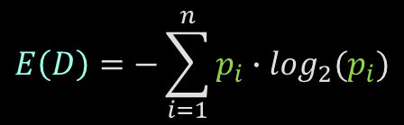
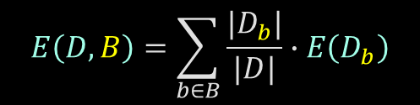
Entropy-Based Binning
Balanced Allocation
Cuckoo Hashing
Data Binning
find bin boundaries that maximize the information gain or minimize the uncertainty within each bin.
Calculate Entropy:
2. Calculate Entropy given a bin:
3. Calculate Information gain:
$$E\left(D\right)=−\sum_{i=1}^{n}{p_{i}∙\log_{2}(p_{i})}$$
$$E\left(D,B\right)=\sum_{b∈B}{\frac{{|D}_{b}|}{|D|}∙E\left(D_{b}\right)}$$
$$IG= E\left(D\right)−E\left(D,B\right)$$

Slide 13

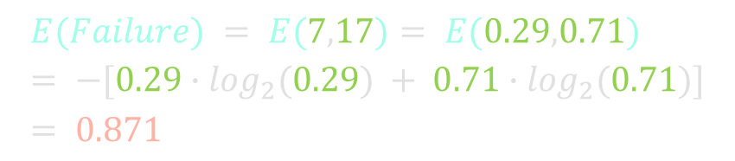
Entropy-Based Binning
Balanced Allocation
Cuckoo Hashing
Data Binning
O-Ring Failure | Temperature
Y | 53
Y | 56
Y | 57
N | 63
N | 66
N | 67
N | 67
N | 67
N | 68
N | 69
N | 70
Y | 70
Y | 70
Y | 70
N | 72
N | 73
N | 75
Y | 75
N | 76
N | 76
N | 78
N | 79
N | 80
N | 81
Calculate Entropy:
$$E\left(D\right)=−\sum_{i=1}^{n}{p_{i}∙\log_{2}(p_{i})}$$
O-Ring Failure
Y | N
7 | 17
$$E(Failure) = E(7,17)= E(0.29,0.71) = −[0.29∙\log_{2}⁡(0.29) + 0.71∙\log_{2}⁡(0.71)]= 0.871$$

Slide 14
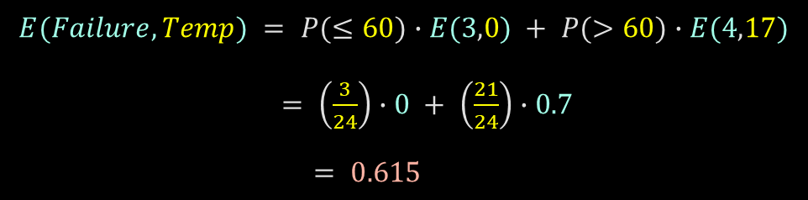
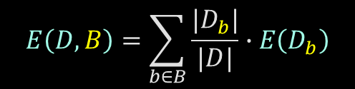
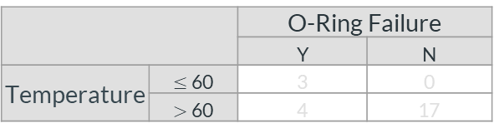
Entropy-Based Binning
Balanced Allocation
Cuckoo Hashing
Data Binning
2. Calculate Entropy given a bin:
O-Ring Failure | Temperature
Y | 53
Y | 56
Y | 57
N | 63
N | 66
N | 67
N | 67
N | 67
N | 68
N | 69
N | 70
Y | 70
Y | 70
Y | 70
N | 72
N | 73
N | 75
Y | 75
N | 76
N | 76
N | 78
N | 79
N | 80
N | 81
$$E\left(D,B\right)=\sum_{b∈B}{\frac{{|D}_{b}|}{|D|}∙E\left(D_{b}\right)}$$
 |  | O-Ring Failure
 |  | Y | N
Temperature | $≤$60 | 3 | 0
 | $>$60 | 4 | 17
$$E(Failure,Temp) = P(≤60)∙E(3,0) + P(>60)∙E(4,17)$$
$= \left(\frac{3}{24}\right)∙0 + \left(\frac{21}{24}\right)∙0.7$
$= 0.615$

Slide 15
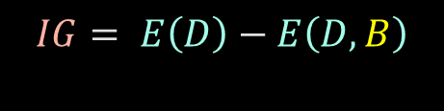
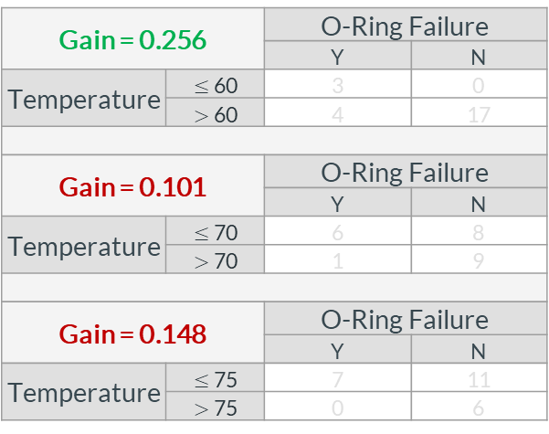
Entropy-Based Binning
Balanced Allocation
Cuckoo Hashing
Data Binning
3. Calculate Information gain:
O-Ring Failure | Temperature
Y | 53
Y | 56
Y | 57
N | 63
N | 66
N | 67
N | 67
N | 67
N | 68
N | 69
N | 70
Y | 70
Y | 70
Y | 70
N | 72
N | 73
N | 75
Y | 75
N | 76
N | 76
N | 78
N | 79
N | 80
N | 81
$$IG= E\left(D\right)−E\left(D,B\right)$$
Gain = 0.256 |  | O-Ring Failure
 |  | Y | N
Temperature | $≤$60 | 3 | 0
 | $>$60 | 4 | 17
Gain = 0.101 |  | O-Ring Failure
 |  | Y | N
Temperature | $≤$70 | 6 | 8
 | $>$70 | 1 | 9
Gain = 0.148 |  | O-Ring Failure
 |  | Y | N
Temperature | $≤$75 | 7 | 11
 | $>$75 | 0 | 6

Slide 16
Cuckoo Hashing
Balanced Allocation
Data Binning
Cuckoo Hashing

Slide 17
Hashing
Balanced Allocation
Data Binning
Cuckoo Hashing
Keys
Hash Function
Hash Table
0
John
1
John
2
Moshe
Moshe
3
Abraham
Abraham
4
Boris
5
Boris
6
7

Slide 18
Hashing
Balanced Allocation
Data Binning
Cuckoo Hashing
Keys
Hash Function
Hash Table
Abraham
0
John
1
2
Moshe
John
3
Abraham
4
Boris
5
6
Moshe
7
Boris

Slide 19
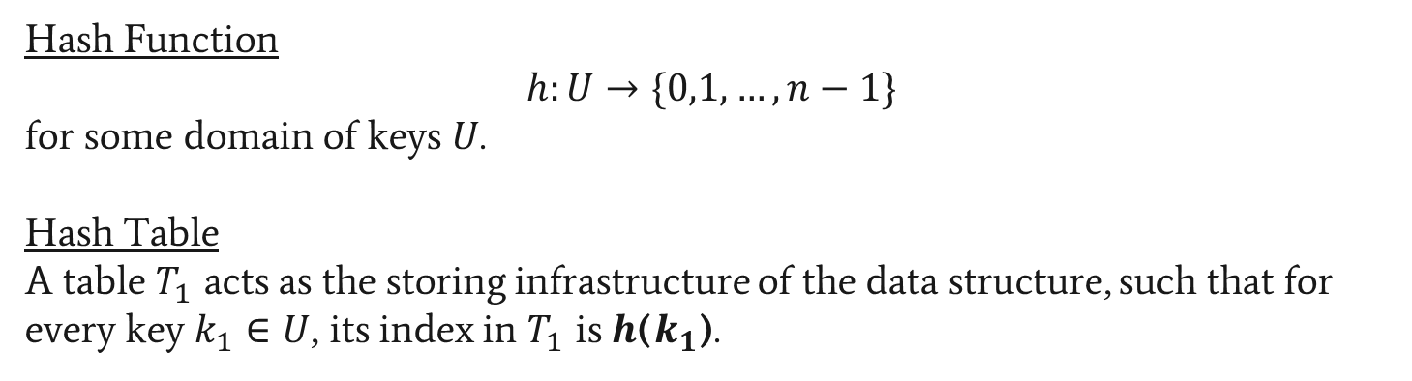
Hashing
Balanced Allocation
Data Binning
Cuckoo Hashing
Hash Function
$$h:U→\{0,1,…,n−1\}$$
for some domain of keys $U$.
Hash Table
A table $T_{1}$ acts as the storing infrastructure of the data structure, such that for every key $k_{1}∈U$, its index in $T_{1}$ is $h$($k_{1}$).

Slide 20



Hashing - Operations
Balanced Allocation
Data Binning
Cuckoo Hashing
Insert
Lookup
Delete
All operations’ complexity is O(n) when using Linked Lists
All operations’ complexity is O(logn) when using BST
Amortized complexity is O(1)

Slide 21


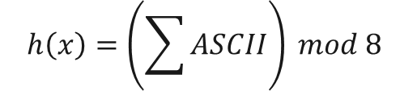


Hashing - Example
Balanced Allocation
Data Binning
Cuckoo Hashing
Keys
Hash Function
Hash Table
0
$$h\left(John\right)=7$$
John
1
2
$$h\left(Moshe\right)=4$$
Moshe
3
$$h\left(Abraham\right)=4$$
Abraham
4
$$h\left(Boris\right)=7$$
Boris
5
6
7
$$h\left(x\right)=\left(\sum{ASCII}\right) mod 8$$

Slide 22
Hashing - Example
Balanced Allocation
Data Binning
Cuckoo Hashing
Keys
Hash Function
Hash Table
Insert(John)
0
$$h\left(John\right)=7$$
John
1
2
$$h\left(Moshe\right)=4$$
Moshe
3
$$h\left(Abraham\right)=4$$
Abraham
4
$$h\left(Boris\right)=7$$
Boris
5
6
John
7
$$h\left(x\right)=\left(\sum{ASCII}\right) mod 8$$

Slide 23
Hashing - Example
Balanced Allocation
Data Binning
Cuckoo Hashing
Keys
Hash Function
Hash Table
Insert(Moshe)
0
$$h\left(John\right)=7$$
John
1
2
$$h\left(Moshe\right)=4$$
Moshe
3
$$h\left(Abraham\right)=4$$
Abraham
4
Moshe
$$h\left(Boris\right)=7$$
Boris
5
6
John
7
$$h\left(x\right)=\left(\sum{ASCII}\right) mod 8$$

Slide 24
Hashing - Example
Balanced Allocation
Data Binning
Cuckoo Hashing
Keys
Hash Function
Hash Table
Insert(Abraham)
0
$$h\left(John\right)=7$$
John
1
2
$$h\left(Moshe\right)=4$$
Moshe
3
$$h\left(Abraham\right)=4$$
Abraham
Abraham
4
Moshe
$$h\left(Boris\right)=7$$
Boris
5
6
John
7
$$h\left(x\right)=\left(\sum{ASCII}\right) mod 8$$

Slide 25
Hashing - Example
Balanced Allocation
Data Binning
Cuckoo Hashing
Keys
Hash Function
Hash Table
Insert(Boris)
0
$$h\left(John\right)=7$$
John
1
2
$$h\left(Moshe\right)=4$$
Moshe
3
$$h\left(Abraham\right)=4$$
Abraham
Abraham
4
Moshe
$$h\left(Boris\right)=7$$
Boris
5
6
7
Boris
John
$$h\left(x\right)=\left(\sum{ASCII}\right) mod 8$$

Slide 26
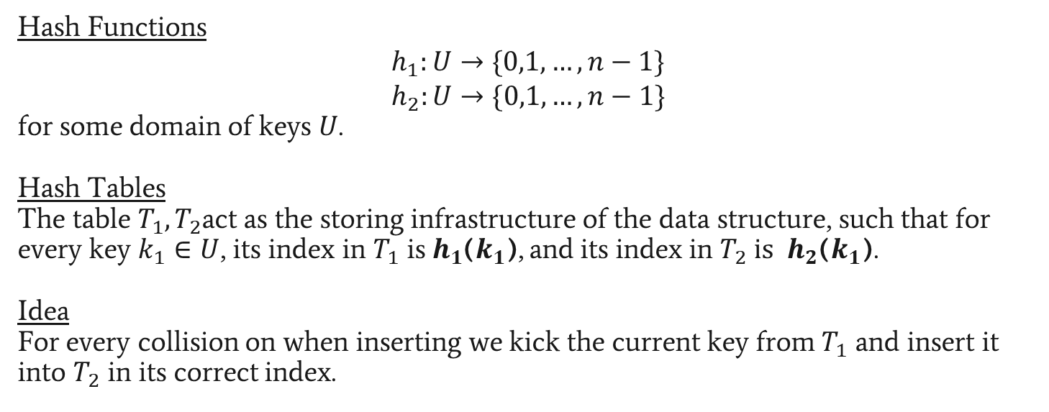
Cuckoo Hashing
Balanced Allocation
Data Binning
Cuckoo Hashing
Hash Functions
$$h_{1}:U→\{0,1,…,n−1\}$$
$$h_{2}:U→\{0,1,…,n−1\}$$
for some domain of keys $U$.
Hash Tables
The table $T_{1},T_{2}$act as the storing infrastructure of the data structure, such that for every key $k_{1}∈U$, its index in $T_{1}$ is$h_{1}$($k_{1}$), and its index in $T_{2} is$ $h_{2}$($k_{1}$).
Idea
For every collision on when inserting we kick the current key from $T_{1}$ and insert it into $T_{2}$ in its correct index.

Slide 27
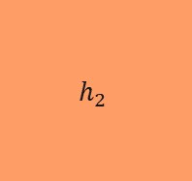



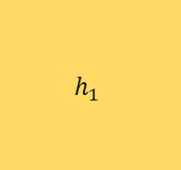



Cuckoo Hashing
Balanced Allocation
Data Binning
Cuckoo Hashing
Keys
Hash Functions
Hash Table 1
Hash Table 2
$$h_{1}$$
0
0
$$k_{1}$$
1
1
$$k_{2}$$
2
2
$$k_{3}$$
3
3
$$k_{4}$$
4
4
$$h_{2}$$
$$k_{5}$$
5
5
$$k_{6}$$
6
6
7
7

Slide 28
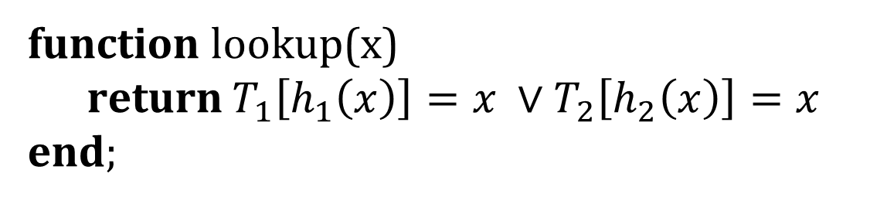
Cuckoo Hashing - Lookup
Balanced Allocation
Data Binning
Cuckoo Hashing
function lookup(x)
return $T_{1}\left[h_{1}\left(x\right)\right]=x ∨T_{2}\left[h_{2}\left(x\right)\right]=x$
end;

Slide 29
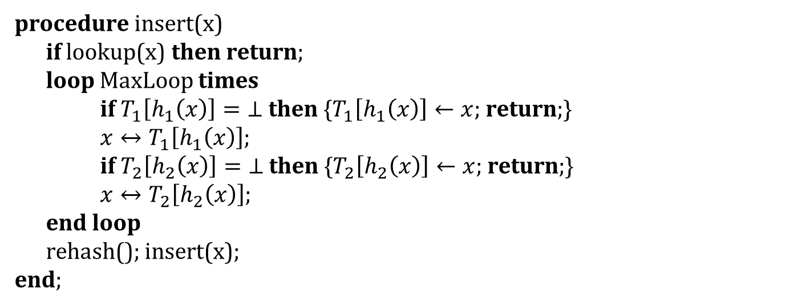
Cuckoo Hashing - Insert
Balanced Allocation
Data Binning
Cuckoo Hashing
procedure insert(x)
if lookup(x) then return;
loop MaxLoop times
if $T_{1}\left[h_{1}\left(x\right)\right]=\text{⊥}$ then {$T_{1}\left[h_{1}\left(x\right)\right]←x$; return;}
$x↔T_{1}\left[h_{1}\left(x\right)\right]$;
if $T_{2}\left[h_{2}\left(x\right)\right]=\text{⊥}$ then {$T_{2}\left[h_{2}\left(x\right)\right]←x$; return;}
$x↔T_{2}\left[h_{2}\left(x\right)\right]$;
end loop
rehash(); insert(x);
end;
*$x↔y$ expresses x and y are being swapped.

Slide 30
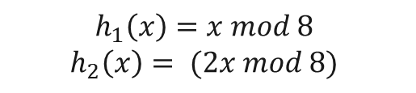






Cuckoo Hashing
Balanced Allocation
Data Binning
Cuckoo Hashing
Keys
Hash Functions
Hash Table 1
Hash Table 2
$$h_{1}\left(51\right)=3$$
51
$$h_{1}$$
0
0
1
1
$$h_{1}\left(133\right)=5$$
133
2
2
$$h_{1}\left(662\right)=6$$
662
3
3
$$h_{1}\left(534\right)=6$$
534
$$h_{2}$$
4
4
5
5
$$h_{1}\left(23\right)=7$$
23
6
6
$$h_{1}\left(445\right)=5$$
445
7
7
$$h_{1}\left(x\right)=x mod 8$$
$$h_{2}\left(x\right)= (2x mod 8)$$

Slide 31
Cuckoo Hashing
Balanced Allocation
Data Binning
Cuckoo Hashing
Keys
Hash Functions
Hash Table 1
Hash Table 2
Insert(534)
$$h_{1}\left(51\right)=3$$
51
$$h_{1}$$
0
0
1
1
$$h_{1}\left(133\right)=5$$
133
2
2
$$h_{1}\left(662\right)=6$$
662
51
3
3
$$h_{1}\left(534\right)=6$$
534
4
4
534
$$h_{2}$$
5
5
133
$$h_{1}\left(23\right)=7$$
23
6
6
662
$$h_{1}\left(445\right)=5$$
445
7
7
Collision
$$h_{1}\left(x\right)=x mod 8$$
$$h_{2}\left(x\right)= (2x mod 8)$$

Slide 32

Cuckoo Hashing
Balanced Allocation
Data Binning
Cuckoo Hashing
Keys
Hash Functions
Hash Table 1
Hash Table 2
Insert(534)
$$h_{1}\left(51\right)=3$$
51
$$h_{1}$$
0
0
1
1
$$h_{1}\left(133\right)=5$$
133
2
2
$$h_{1}\left(662\right)=6$$
662
51
3
3
$$h_{1}\left(534\right)=6$$
534
$$h_{2}$$
4
4
5
5
133
$$h_{1}\left(23\right)=7$$
23
6
6
534
$$h_{1}\left(445\right)=5$$
445
7
7
Collision
$$h_{2}\left(662\right)= \left(2x mod 8\right)=4$$
$$h_{1}\left(x\right)=x mod 8$$
$$h_{2}\left(x\right)= (2x mod 8)$$
662

Slide 33
Cuckoo Hashing
Balanced Allocation
Data Binning
Cuckoo Hashing
Keys
Hash Functions
Hash Table 1
Hash Table 2
Insert(534)
$$h_{1}\left(51\right)=3$$
51
$$h_{1}$$
0
0
1
1
$$h_{1}\left(133\right)=5$$
133
2
2
$$h_{1}\left(662\right)=6$$
662
51
3
3
4
4
$$h_{1}\left(534\right)=6$$
534
$$h_{2}$$
662
5
5
133
$$h_{1}\left(23\right)=7$$
23
6
6
534
$$h_{1}\left(445\right)=5$$
445
7
7
Collision
$$h_{2}\left(662\right)= \left(2x mod 8\right)=4$$
$$h_{1}\left(x\right)=x mod 8$$
$$h_{2}\left(x\right)= (2x mod 8)$$

Slide 34
Cuckoo Hashing
Balanced Allocation
Data Binning
Cuckoo Hashing
Keys
Hash Functions
Hash Table 1
Hash Table 2
Insert(23)
$$h_{1}\left(51\right)=3$$
51
$$h_{1}$$
0
0
1
1
$$h_{1}\left(133\right)=5$$
133
2
2
$$h_{1}\left(662\right)=6$$
662
51
3
3
4
4
$$h_{1}\left(534\right)=6$$
534
$$h_{2}$$
662
5
5
133
$$h_{1}\left(23\right)=7$$
23
6
6
534
$$h_{1}\left(445\right)=5$$
445
7
7
23
$$h_{1}\left(x\right)=x mod 8$$
$$h_{2}\left(x\right)= (2x mod 8)$$

Slide 35
Cuckoo Hashing
Balanced Allocation
Data Binning
Cuckoo Hashing
Keys
Hash Functions
Hash Table 1
Hash Table 2
Insert(445)
$$h_{1}\left(51\right)=3$$
51
$$h_{1}$$
0
0
1
1
$$h_{1}\left(133\right)=5$$
133
2
2
$$h_{1}\left(662\right)=6$$
662
51
3
3
4
662
$$h_{1}\left(534\right)=6$$
534
$$h_{2}$$
4
5
5
133
$$h_{1}\left(23\right)=7$$
23
6
6
534
$$h_{1}\left(445\right)=5$$
445
445
7
7
23
Collision
$$h_{1}\left(x\right)=x mod 8$$
$$h_{2}\left(x\right)= (2x mod 8)$$

Slide 36

Cuckoo Hashing
Balanced Allocation
Data Binning
Cuckoo Hashing
Keys
Hash Functions
Hash Table 1
Hash Table 2
Insert(445)
$$h_{1}\left(51\right)=3$$
51
$$h_{1}$$
0
0
1
1
$$h_{1}\left(133\right)=5$$
133
2
2
$$h_{1}\left(662\right)=6$$
662
51
3
3
4
662
$$h_{1}\left(534\right)=6$$
534
$$h_{2}$$
4
5
5
445
$$h_{1}\left(23\right)=7$$
23
6
6
534
$$h_{1}\left(445\right)=5$$
445
7
7
23
Collision
$$h_{2}\left(133\right)= \left(2x mod 8\right)=2$$
$$h_{1}\left(x\right)=x mod 8$$
$$h_{2}\left(x\right)= (2x mod 8)$$
133

Slide 37
Cuckoo Hashing
Balanced Allocation
Data Binning
Cuckoo Hashing
Keys
Hash Functions
Hash Table 1
Hash Table 2
Insert(445)
$$h_{1}\left(51\right)=3$$
51
$$h_{1}$$
0
0
1
1
$$h_{1}\left(133\right)=5$$
133
2
133
2
$$h_{1}\left(662\right)=6$$
662
51
3
3
4
662
$$h_{1}\left(534\right)=6$$
534
$$h_{2}$$
4
5
5
445
$$h_{1}\left(23\right)=7$$
23
6
6
534
$$h_{1}\left(445\right)=5$$
445
7
7
23
Collision
$$h_{2}\left(133\right)= \left(2x mod 8\right)=2$$
$$h_{1}\left(x\right)=x mod 8$$
$$h_{2}\left(x\right)= (2x mod 8)$$

Slide 38
Cuckoo Hashing
Balanced Allocation
Data Binning
Cuckoo Hashing
Keys
Hash Functions
Hash Table 1
Hash Table 2
$$h_{1}\left(51\right)=3$$
51
$$h_{1}$$
0
0
1
1
$$h_{1}\left(133\right)=5$$
133
2
133
2
$$h_{1}\left(662\right)=6$$
662
51
3
3
4
662
$$h_{1}\left(534\right)=6$$
534
$$h_{2}$$
4
5
5
445
$$h_{1}\left(23\right)=7$$
23
6
6
534
$$h_{1}\left(445\right)=5$$
445
7
7
23
$$h_{1}\left(x\right)=x mod 8$$
$$h_{2}\left(x\right)= (2x mod 8)$$

Slide 39

Cuckoo Hashing
Balanced Allocation
Data Binning
Cuckoo Hashing
Keys
Hash Functions
Hash Table 1
Hash Table 2
$$h_{1}\left(51\right)=3$$
51
$$h_{1}$$
0
0
1
1
$$h_{1}\left(133\right)=5$$
133
2
133
2
$$h_{1}\left(662\right)=6$$
662
51
3
3
4
662
$$h_{1}\left(534\right)=6$$
534
$$h_{2}$$
4
5
5
445
$$h_{1}\left(23\right)=7$$
23
6
6
534
534
$$h_{1}\left(445\right)=5$$
445
7
7
23
$$h_{1}\left(22\right)=6$$
22
22
$$h_{1}\left(x\right)=x mod 8$$
$$h_{2}\left(x\right)= (2x mod 8)$$

Slide 40

Cuckoo Hashing
Balanced Allocation
Data Binning
Cuckoo Hashing
Keys
Hash Functions
Hash Table 1
Hash Table 2
Insert(445)
$$h_{1}\left(51\right)=3$$
51
$$h_{1}$$
0
0
1
1
$$h_{1}\left(133\right)=5$$
133
2
133
2
$$h_{1}\left(662\right)=6$$
662
51
3
3
4
4
662
$$h_{1}\left(534\right)=6$$
534
$$h_{2}$$
662
5
5
445
$$h_{1}\left(23\right)=7$$
23
6
6
22
$$h_{1}\left(445\right)=5$$
445
7
7
23
$$h_{1}\left(22\right)=6$$
22
$$h_{2}\left(534\right)= \left(2x mod 8\right)=4$$
$$h_{1}\left(x\right)=x mod 8$$
$$h_{2}\left(x\right)= (2x mod 8)$$
Collision
534

Slide 41

Cuckoo Hashing
Balanced Allocation
Data Binning
Cuckoo Hashing
Keys
Hash Functions
Hash Table 1
Hash Table 2
Insert(445)
$$h_{1}\left(51\right)=3$$
51
$$h_{1}$$
0
0
1
1
$$h_{1}\left(133\right)=5$$
133
2
133
2
$$h_{1}\left(662\right)=6$$
662
51
3
3
4
534
4
$$h_{1}\left(534\right)=6$$
534
$$h_{2}$$
662
5
5
445
$$h_{1}\left(23\right)=7$$
23
6
6
22
$$h_{1}\left(445\right)=5$$
445
7
7
23
$$h_{1}\left(22\right)=6$$
22
$$h_{1}\left(662\right)= \left(x mod 8\right)=6$$
$$h_{1}\left(x\right)=x mod 8$$
$$h_{2}\left(x\right)= (2x mod 8)$$
Collision
662

Slide 42
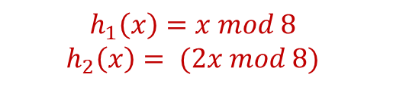

Cuckoo Hashing
Balanced Allocation
Data Binning
Cuckoo Hashing
Keys
Hash Functions
Hash Table 1
Hash Table 2
Insert(445)
$$h_{1}\left(51\right)=3$$
51
$$h_{1}$$
0
0
1
1
$$h_{1}\left(133\right)=5$$
133
2
133
2
$$h_{1}\left(662\right)=6$$
662
51
3
3
4
534
4
$$h_{1}\left(534\right)=6$$
534
$$h_{2}$$
662
5
5
445
$$h_{1}\left(23\right)=7$$
23
6
6
22
$$h_{1}\left(445\right)=5$$
445
7
7
23
$$h_{1}\left(22\right)=6$$
22
$$h_{1}\left(662\right)= \left(x mod 8\right)=6$$
$$h_{1}\left(x\right)=x mod 8$$
$$h_{2}\left(x\right)= (2x mod 8)$$
Collision
662

Slide 43
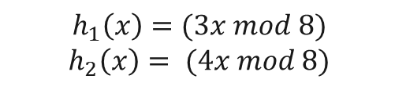

Cuckoo Hashing
Balanced Allocation
Data Binning
Cuckoo Hashing
Keys
Hash Functions
Hash Table 1
Hash Table 2
Insert(445)
$$h_{1}\left(51\right)=3$$
51
$$h_{1}$$
0
0
1
1
$$h_{1}\left(133\right)=5$$
133
2
133
2
$$h_{1}\left(662\right)=6$$
662
51
3
3
4
534
4
$$h_{1}\left(534\right)=6$$
534
$$h_{2}$$
662
5
5
445
$$h_{1}\left(23\right)=7$$
23
6
6
22
$$h_{1}\left(445\right)=5$$
445
7
7
23
$$h_{1}\left(22\right)=6$$
22
$$h_{1}\left(662\right)= \left(3x mod 8\right)=2$$
$$h_{1}\left(x\right)=(3x mod 8)$$
$$h_{2}\left(x\right)= (4x mod 8)$$
662

Slide 44
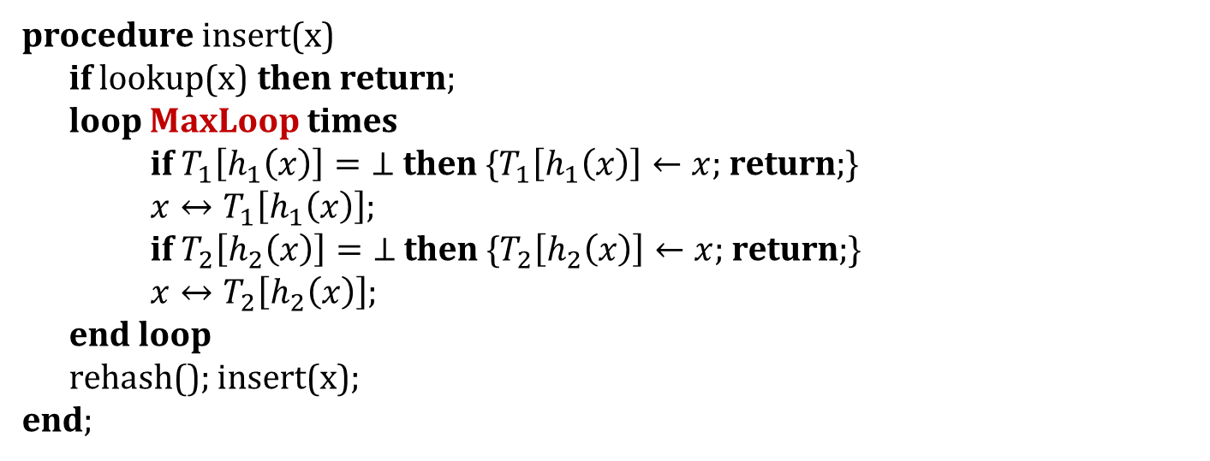
Cuckoo Hashing - Insert
Balanced Allocation
Data Binning
Cuckoo Hashing
procedure insert(x)
if lookup(x) then return;
loop MaxLoop times
if $T_{1}\left[h_{1}\left(x\right)\right]=\text{⊥}$ then {$T_{1}\left[h_{1}\left(x\right)\right]←x$; return;}
$x↔T_{1}\left[h_{1}\left(x\right)\right]$;
if $T_{2}\left[h_{2}\left(x\right)\right]=\text{⊥}$ then {$T_{2}\left[h_{2}\left(x\right)\right]←x$; return;}
$x↔T_{2}\left[h_{2}\left(x\right)\right]$;
end loop
rehash(); insert(x);
end;
How do we choose MaxLoop?
*$x↔y$ expresses x and y are being swapped.

Slide 45
Cuckoo Hashing - Time Complexity
Balanced Allocation
Data Binning
Cuckoo Hashing
Search and delete are O(1) in the worst case.
constant number of “nests”
Insert has amortized cost of O(1)
worst case is still O(n) due to rehash
worst case of number of evictions is O(logn)

Slide 46
Balanced Allocation
Cuckoo Hashing
Data Binning
Balanced Allocation

Slide 47
Balanced Allocation
Cuckoo Hashing
Data Binning
Balanced Allocation
As seen before, for cuckoo hashing, two items cannot be placed in the same bin so the existing item is kicked and placed into the other table.
balanced allocation is a technique used to divide k elements into m = k/ln(ln(k)) bins in which each bin has at most O(ln(ln(k)) items with very high probability (different from the cuckoo because we can put multiple items into one bin).
How is it done? Each time we insert an element we choose 2 random bins (using hash over uniform distribution) and put it in the bin that is less full

Slide 48
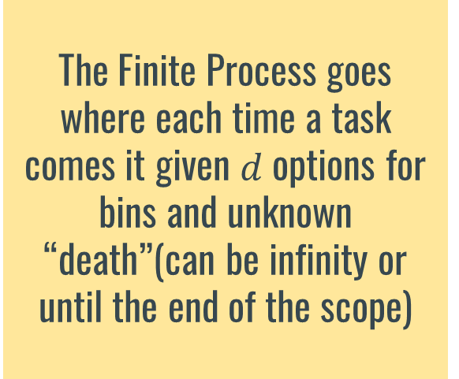
Finite Process and Infinite Process
Cuckoo Hashing
Data Binning
Balanced Allocation
Finite Process
Infinite Process
The Finite Process goes where each time a task comes it given $d$ options for bins and unknown “death”(can be infinity or until the end of the scope)
In the Infinite Process start with n the n balls place arbitrary for example all in the first each time 2 tasks are chosen 1 get deleted and the other one get inserted with d options

Slide 49
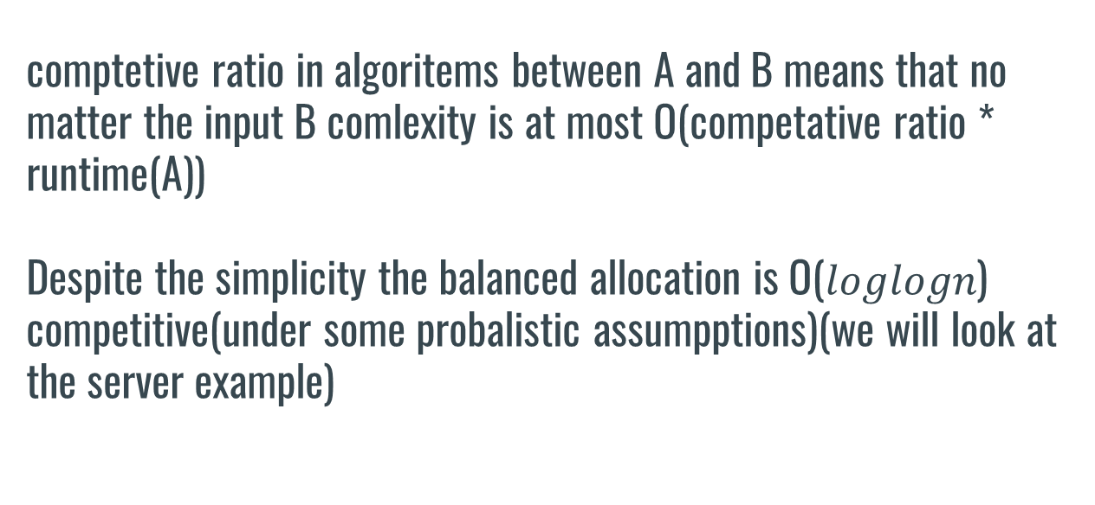
Balanced allocation
comptetive ratio in algoritems between A and B means that no matter the input B comlexity is at most O(competative ratio * runtime(A)) Despite the simplicity the balanced allocation is O($loglogn$) competitive(under some probalistic assumpptions)(we will look at the server example)
Cuckoo Hashing
Data Binning
Balanced Allocation

Slide 50
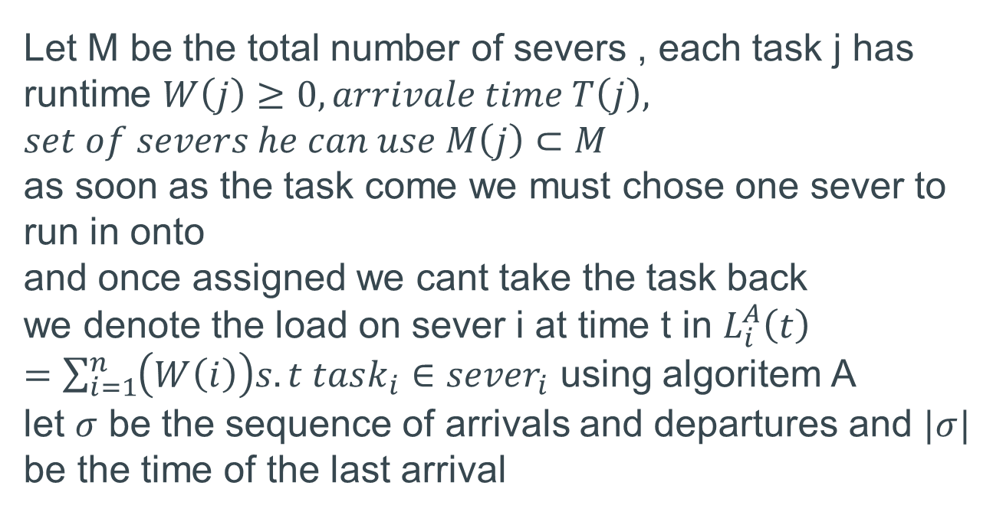
Let M be the total number of severs , each task j has runtime $W\left(j\right)≥0, arrivale time T\left(j\right),$ $$set of severs he can use M\left(j\right)⊂M$$ as soon as the task come we must chose one sever to run in onto and once assigned we cant take the task back we denote the load on sever i at time t in $L_{i}^{A}\left(t\right)=\sum_{i=1}^{n}{\left(W\left(i\right)\right)s.t task_{i}∈sever_{i}}$ using algoritem A let $σ$ be the sequence of arrivals and departures and $|σ|$ be the time of the last arrival
prove
Cuckoo Hashing
Data Binning
Balanced Allocation

Slide 51
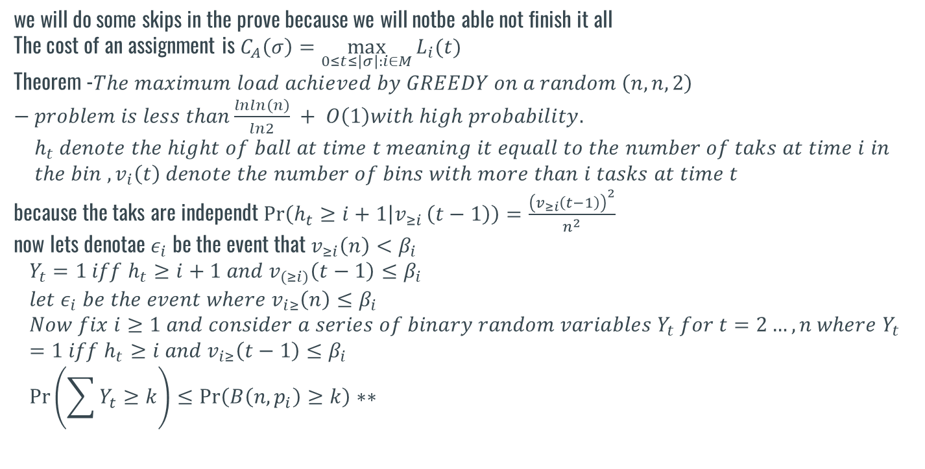
we will do some skips in the prove because we will notbe able not finish it all The cost of an assignment is $C_{A}\left(σ\right)=\max_{0≤t≤\left|σ\right|:i∈M}{L_{i}(t)}$ Theorem -$The maximum load achieved by GREEDY on a random \left(n, n, 2\right)−problem is less than\frac{lnln\left(n\right)}{ln2} + O\left(1\right)with high probability.$ $$h_{t} denote the hight of ball at time t meaning it equall to the number of taks at time i in \\ the bin , v_{i}\left(t\right) denote the number of bins with more than i tasks at time t$$ because the taks are independt $\operatorname{Pr}\left(h_{t}≥i+1 | v_{≥i }\left(t−1\right)\right)=\frac{{\left(v_{≥i}\left(t−1\right)\right)}^{2}}{n^{2}}$ now lets denotae $ε_{i}$ be the event that $v_{≥i}\left(n\right)<β_{i}$ $$Y_{t}=1 iff h_{t}≥i+1 and v_{\left(≥i\right)}\left(t−1\right)≤β_{i} \\ let ε_{i} be the event where v_{i≥}\left(n\right)≤β_{i} \\ Now fix i≥1 and consider a series of binary random variables Y_{t} for t=2…,n where Y_{t}=1 iff h_{t}≥i and v_{i≥}\left(t−1\right)≤β_{i} \\ \operatorname{Pr}\left(\sum{Y_{t}}≥k\right)≤\operatorname{Pr}\left(B\left(n,p_{i}\right)≥k\right)∗∗$$
prove
Cuckoo Hashing
Data Binning
Balanced Allocation

Slide 52
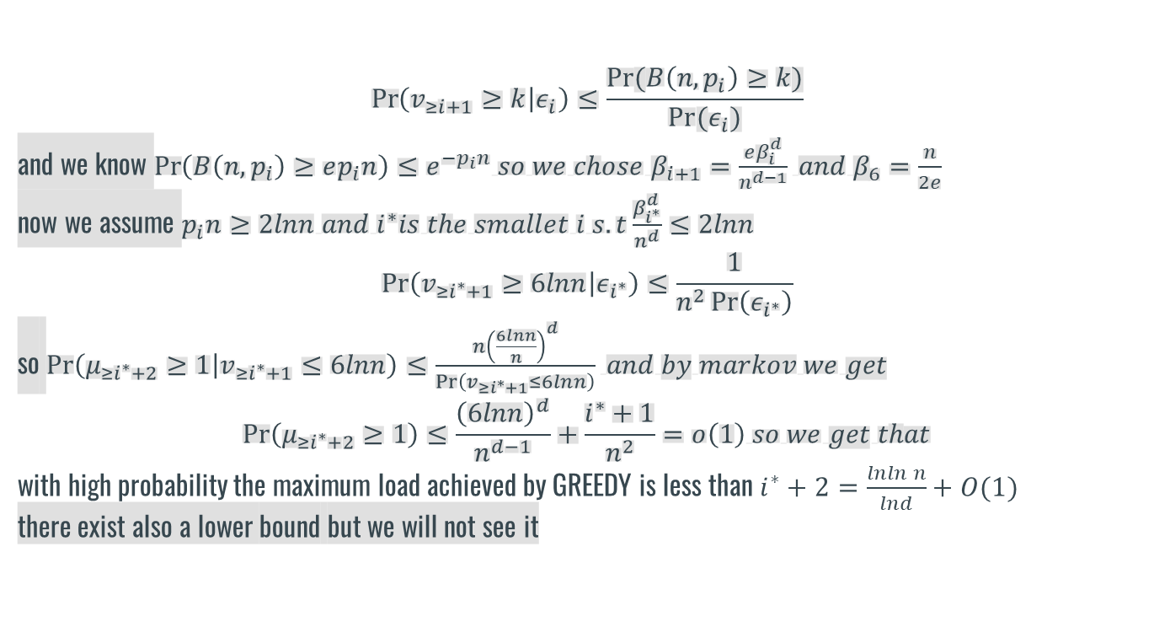
$$\operatorname{Pr}\left(v_{≥i+1}≥k | ε_{i}\right)≤\frac{Pr⁡(B\left(n,p_{i}\right)≥k)}{Pr⁡(ε_{i})}$$ and we know $\operatorname{Pr}\left(B\left(n,p_{i}\right)≥ep_{i}n\right)≤e^{−p_{i}n} so we chose β_{i+1}=\frac{eβ_{i}^{d}}{n^{d−1}} and β_{6}=\frac{n}{2e}$ now we assume $p_{i}n≥2lnn and i^{∗}is the smallet i s.t\frac{β_{i^{∗}}^{d}}{n^{d}}≤2lnn$ $$\operatorname{Pr}\left(v_{≥i^{∗}+1}≥6lnn | ε_{i^{∗}}\right)≤\frac{1}{n^{2}\operatorname{Pr}\left(ε_{i^{∗}}\right)}$$ so $\operatorname{Pr}\left(μ_{≥i^{∗}+2}≥1 | v_{≥i^{∗}+1}≤6lnn\right)≤\frac{n{\left(\frac{6lnn}{n}\right)}^{d}}{\operatorname{Pr}\left(v_{≥i^{∗}+1}≤6lnn\right)} and by markov we get$ $$\operatorname{Pr}\left(μ_{≥i^{∗}+2}≥1\right)≤\frac{{\left(6lnn\right)}^{d}}{n^{d−1}}+\frac{i^{∗}+1}{n^{2}}=o\left(1\right) so we get that$$ with high probability the maximum load achieved by GREEDY is less than $i^{∗}+2=\frac{lnln n}{lnd}+O(1)$ there exist also a lower bound but we will not see it
Cuckoo Hashing
Data Binning
Balanced Allocation

Slide 53
tasks | Arival time | Death time | Severs that can be run on
1 | 1 | 4 | 1,2
2 | 3 | 6 | 1,3
3 | 4 | 6 | 2,3
4 | 5 | 7 | 1,4
5 | 2 | 5 | 3,4
Balanced Allocation example
Time = 1
Task
1
6 | 2 | 100 | 1,3
7 | 3 | 150 | 3,4
1
2
3
4

Slide 54
tasks | Arival time | Death time | Severs that can be run on
1 | 1 | 4 | 1,2
2 | 3 | 6 | 1,3
3 | 4 | 6 | 2,3
4 | 5 | 7 | 1,4
5 | 2 | 5 | 3,4
Balanced Allocation example
Time = 2
Task
Task
6
5
6 | 2 | 100 | 1,3
7 | 3 | 150 | 3,4
Task
1
1
2
3
4

Slide 55
Balanced Allocation example
tasks | Arival time | Death time | Severs that can be run on
1 | 1 | 4 | 1,2
2 | 3 | 6 | 1,3
3 | 4 | 6 | 2,3
4 | 5 | 7 | 1,4
5 | 2 | 5 | 3,4
Time = 3
Task
Task
7
2
6 | 2 | 100 | 1,3
7 | 3 | 150 | 3,4
Task
6
Task
Task
1
5
1
2
3
4

Slide 56


tasks | Arival time | Death time | Severs that can be run on
1 | 1 | 4 | 1,2
2 | 3 | 6 | 1,3
3 | 4 | 6 | 2,3
4 | 5 | 7 | 1,4
5 | 2 | 5 | 3,4
Balanced Allocation example
Time = 4
Task
3
6 | 2 | 100 | 1,3
7 | 3 | 150 | 3,4
Task
Task
2
6
Task
Task
Task
7
1
5
1
2
3
4

Slide 57


tasks | Arival time | Death time | Severs that can be run on
1 | 1 | 4 | 1,2
2 | 3 | 6 | 1,3
3 | 4 | 6 | 2,3
4 | 5 | 7 | 1,4
5 | 2 | 5 | 3,4
Balanced Allocation example
Time = 5
Task
4
6 | 2 | 100 | 1,3
7 | 3 | 150 | 3,4
Task
2
Task
Task
3
Task
Task
7
6
5
1
2
3
4

Slide 58




tasks | Arival time | Death time | Severs that can be run on
1 | 1 | 4 | 1,2
2 | 3 | 6 | 1,3
3 | 4 | 6 | 2,3
4 | 5 | 7 | 1,4
5 | 2 | 5 | 3,4
Balanced Allocation example
Time = 6
6 | 2 | 100 | 1,3
7 | 3 | 150 | 3,4
Task
4
2
Task
6
Task
3
Task
2
Task
7
1
2
3
4

Slide 59


tasks | Arival time | Death time | Severs that can be run on
1 | 1 | 4 | 1,2
2 | 3 | 6 | 1,3
3 | 4 | 6 | 2,3
4 | 5 | 7 | 1,4
5 | 2 | 5 | 3,4
Balanced Allocation example
Time = 7
6 | 2 | 100 | 1,3
7 | 3 | 150 | 3,4
Task
4
2
Task
6
Task
7
1
2
3
4

Slide 60
tasks | Arival time | Death time | Severs that can be run on
1 | 1 | 4 | 1,2
2 | 3 | 6 | 1,3
3 | 4 | 6 | 2,3
4 | 5 | 7 | 1,4
5 | 2 | 5 | 3,4
Balanced Allocation example
Time = 8
6 | 2 | 100 | 1,3
7 | 3 | 150 | 3,4
Task
6
Task
7
1
2
3
4

Slide 61
now lets look at the relation to mpsi denote in the protocols we saw in class allice give bob some secret share of her input and bob or Alice did a calculation but what if the calculation isn’t O(1) that means the fairness brakes because one of them can do signify more calculation and that could reach exponential time in order to divide the tasks equally and remain fairness one can use balanced allocation in order to divide the work between alice and bob in a way which in h.p they will do order of the same work
An example for that can be looked even in protocols lets take an arbitrary protocol that is given the circuit as input one option is that every member (n) will send him some sort of secret share to every one and he will calculate the gate by this can take him more than O(n) time(n^2 communication ) (each one sends to everybody) if one opt to use balanced allocation we can divide the the mission of calculate the gate into smaller missions and get it done more efficiently for example compute it like a tournament and the cost is O(n communication ) and O(n) computation

Slide 62
Yao's Garbled Circuits Protocol: In Yao's protocol, the computation is represented as a Boolean circuit where each gate is garbled (encrypted) based on the input values of the parties. The parties then evaluate the circuit gate-by-gate to compute the result without revealing their inputs to each other. Balanced allocation in Yao's protocol can be achieved by dividing the circuit into smaller parts and distributing these parts among the parties in a balanced manner. For example, if there are 4 parties involved, each responsible for evaluating a quarter of the circuit, the allocation is balanced. This ensures that the computation progresses efficiently without any single party being overloaded. By incorporating balanced allocation into protocols like Yao's Garbled Circuits, multi-party secure computation can be performed efficiently and securely while ensuring fairness among the participating parties.
Cuckoo Hashing
Data Binning
Balanced Allocation

Slide 63
Balanced Allocation
Cuckoo Hashing
Data Binning
Back to Binning…

Slide 64
Scaling PSI Protocols
Balanced Allocation
Cuckoo Hashing
Data Binning
We would like to scale existing PSI protocols
The main problem: Memory consumption
Many implemented PSI protocols quickly exceed the main memory, thereby requiring more engineering effort.

Slide 65
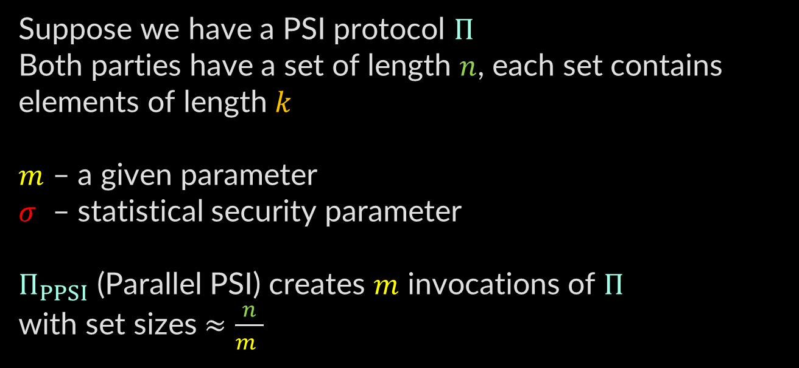
Parallelizing PSI via Binning
Balanced Allocation
Cuckoo Hashing
Data Binning
Suppose we have a PSI protocol $Π$
Both parties have a set of length $n$, each set contains elements of length $k$
$m$ – a given parameter
$σ$ – statistical security parameter
$Π_{PPSI}$ (Parallel PSI) creates $m$ invocations of $Π$
with set sizes $≈\frac{n}{m }$

Slide 66
Parallelizing PSI via Binning
Balanced Allocation
Cuckoo Hashing
Data Binning
1
Partition sets
2
Pad with dummy elements
3
PSI for smaller sets
4
Recover intersection

Slide 67
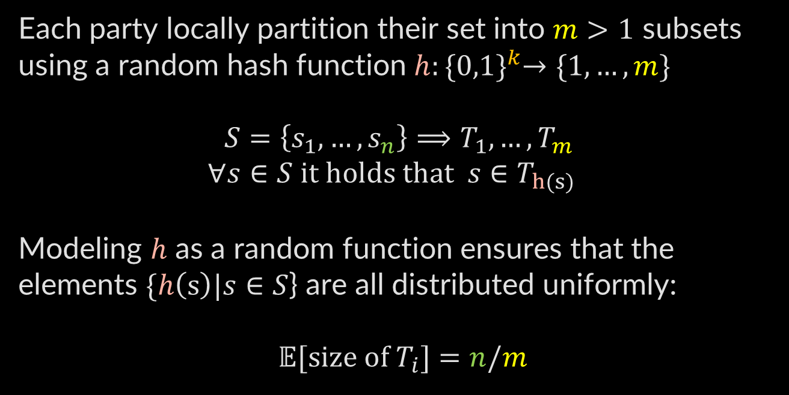
Partition Sets
Balanced Allocation
Cuckoo Hashing
Data Binning
Each party locally partition their set into $m>1$ subsets
using a random hash function $h:{\{0,1\}}^{k}→\{1,…,m\}$
$S=\left\{s_{1},…,s_{n}\right\}⟹T_{1},…,T_{m}$
$$∀s∈S it holds that s∈T_{h(s)}$$
Modeling $h$ as a random function ensures that the elements $\{h\left(s\right)|s∈S$} are all distributed uniformly:
$𝔼[size of T_{i}]=n/m$

Slide 68
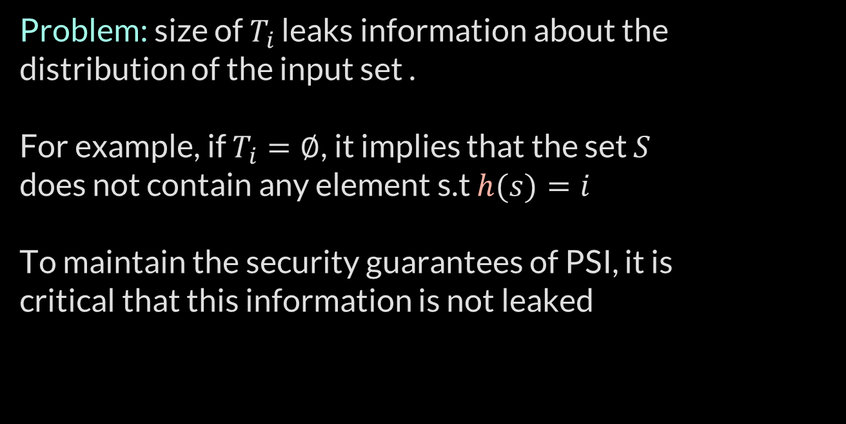
Partition Sets
Balanced Allocation
Cuckoo Hashing
Data Binning
Problem: size of $T_{i}$ leaks information about the distribution of the input set .
For example, if $T_{i}=∅$, it implies that the set $S$
does not contain any element s.t $h(s)=i$
To maintain the security guarantees of PSI, it is
critical that this information is not leaked

Slide 69
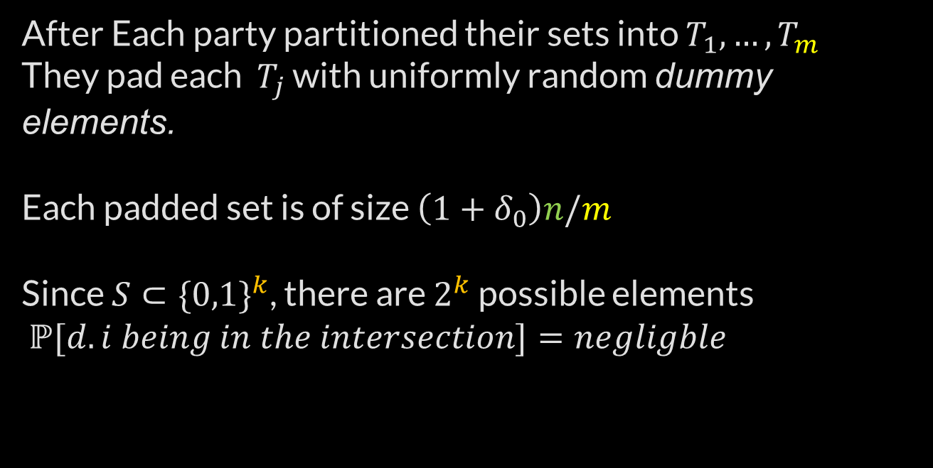
Pad With Dummy Elements
Balanced Allocation
Cuckoo Hashing
Data Binning
After Each party partitioned their sets into $T_{1},…,T_{m}$
They pad each $T_{j}$ with uniformly random dummy elements.
Each padded set is of size $\left(1+δ_{0}\right)n/m$
Since $S⊂{\{0,1\}}^{k}$, there are $2^{k}$ possible elements
$ℙ{[d.i being in the intersection]}=negligble$

Slide 70
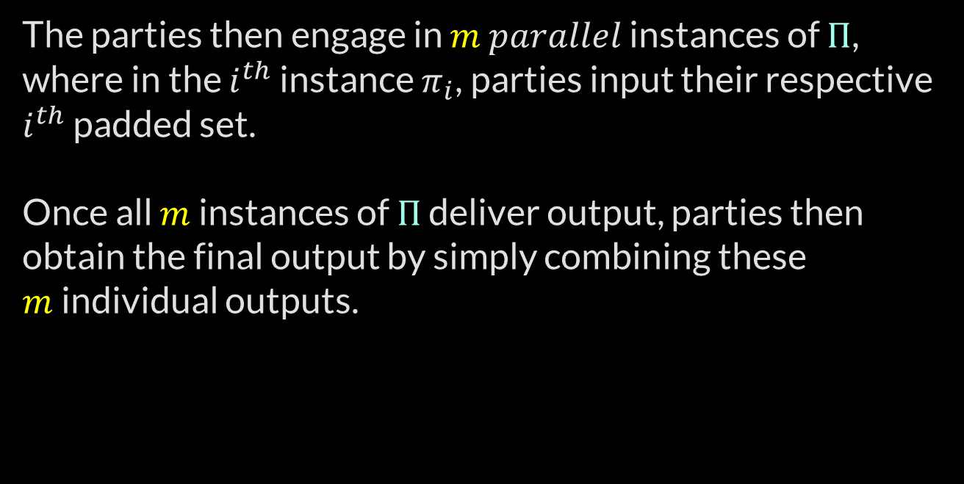
PSI For Smaller Sets & Combine
Balanced Allocation
Cuckoo Hashing
Data Binning
The parties then engage in $m$ $parallel$ instances of $Π$,
where in the $i^{th}$ instance $π_{i}$, parties input their respective $i^{th}$ padded set.
Once all $m$ instances of $Π$ deliver output, parties then obtain the final output by simply combining these
$m$ individual outputs.

Slide 71
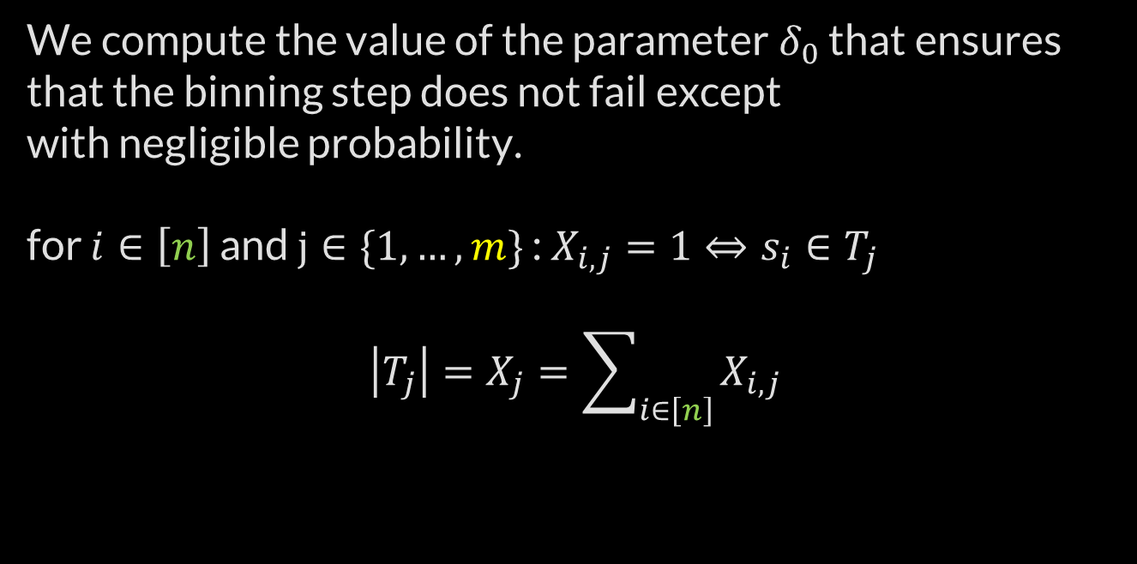
Analysis
Balanced Allocation
Cuckoo Hashing
Data Binning
We compute the value of the parameter $δ_{0}$ that ensures that the binning step does not fail except
with negligible probability.
for $i∈\left[n\right]$ and $j∈\{1,…,m\}$ : $X_{i,j}=1⇔s_{i}∈T_{j}$
$$\left|T_{j}\right|=X_{j}=\sum_{i∈\left[n\right]}{X_{i,j}}$$

Slide 72
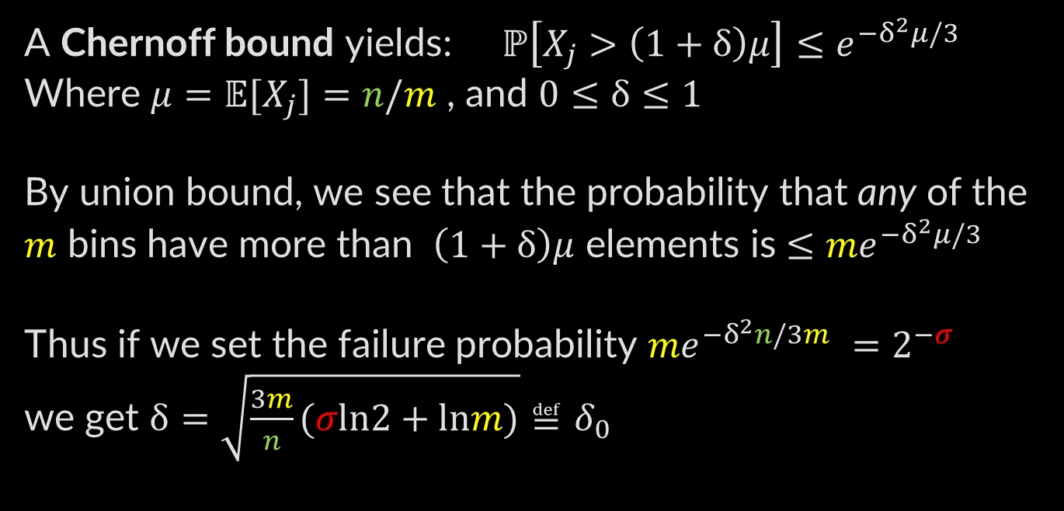
Analysis
Balanced Allocation
Cuckoo Hashing
Data Binning
A Chernoff bound yields: $ℙ\left[X_{j}>\left(1+δ\right)μ\right]≤e^{−δ^{2}μ/3}$
Where $μ=𝔼[X_{j}]=n/m$ , and $0≤δ≤1$
By union bound, we see that the probability that any of the $m$ bins have more than $\left(1+δ\right)μ$ elements is $≤{me}^{−δ^{2}μ/3}$
Thus if we set the failure probability ${me}^{−δ^{2}n/3m }=2^{−σ}$
we get $δ=\sqrt{\frac{3m}{n}(σln2+lnm)}≝δ_{0}$

Slide 73
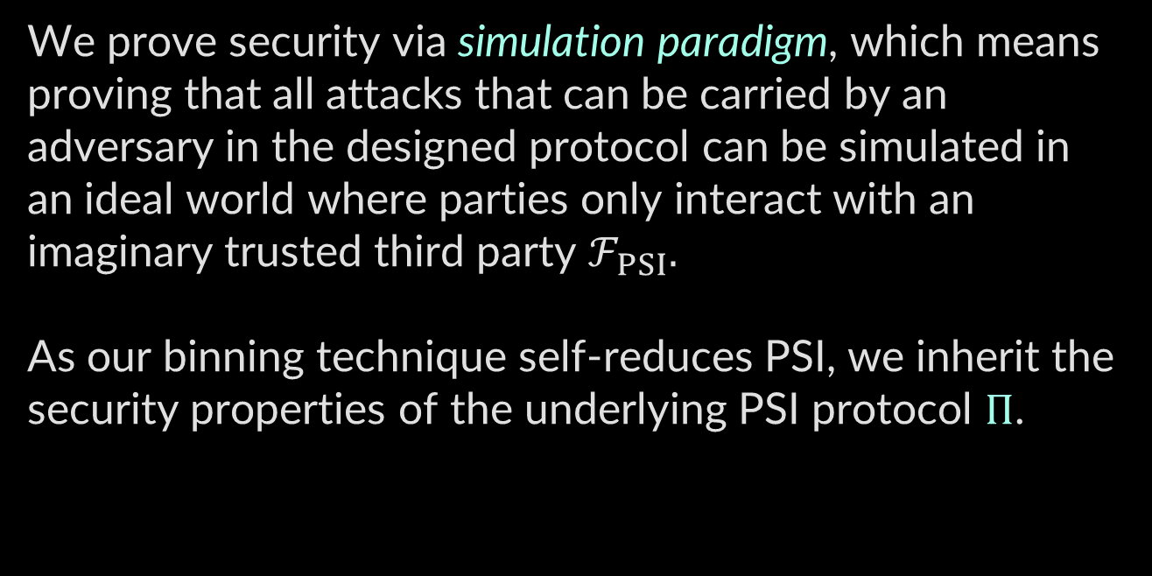
Simulation
Balanced Allocation
Cuckoo Hashing
Data Binning
We prove security via simulation paradigm, which means proving that all attacks that can be carried by an adversary in the designed protocol can be simulated in an ideal world where parties only interact with an imaginary trusted third party $ℱ_{PSI}.$
As our binning technique self-reduces PSI, we inherit the security properties of the underlying PSI protocol $Π$.

Slide 74
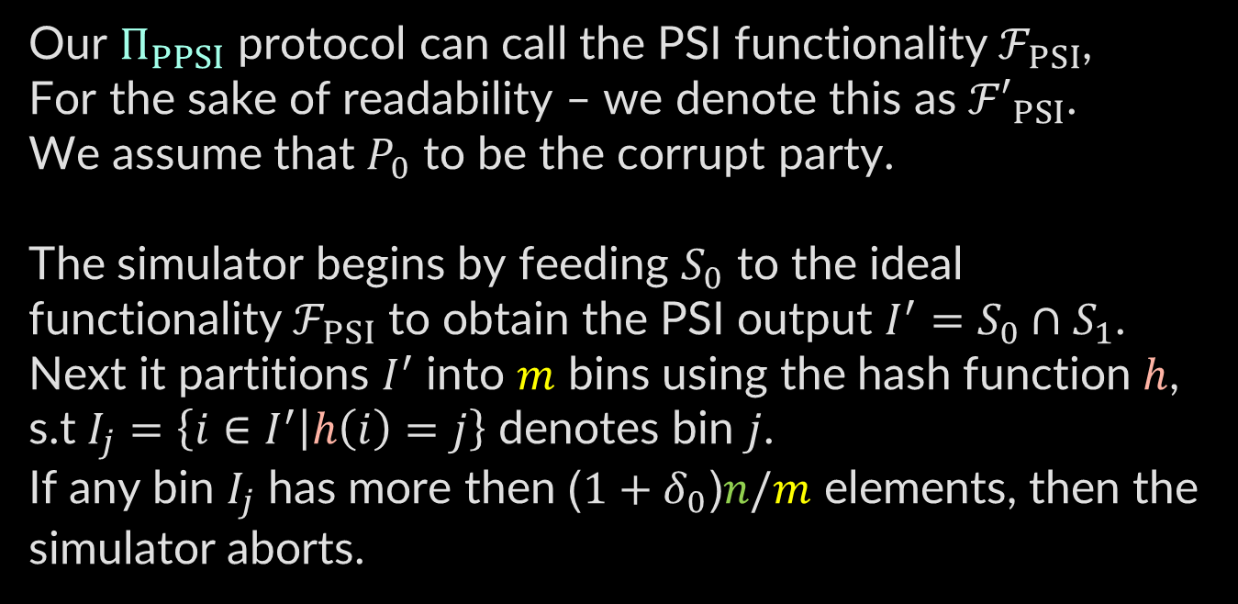
Simulation
Balanced Allocation
Cuckoo Hashing
Data Binning
Our $Π_{PPSI}$ protocol can call the PSI functionality $ℱ_{PSI}$,
For the sake of readability – we denote this as ${ℱ′}_{PSI}$.
We assume that $P_{0}$ to be the corrupt party.
The simulator begins by feeding $S_{0}$ to the ideal functionality $ℱ_{PSI}$ to obtain the PSI output $I^{′}=S_{0}∩S_{1}$.
Next it partitions $I^{′}$ into $m$ bins using the hash function $h$,
s.t $I_{j}=\left\{i∈I^{′} | h\left(i\right)=j\right\}$ denotes bin $j$.
If any bin $I_{j}$ has more then ($1+δ_{0}$)$n/m$ elements, then the simulator aborts.

Slide 75
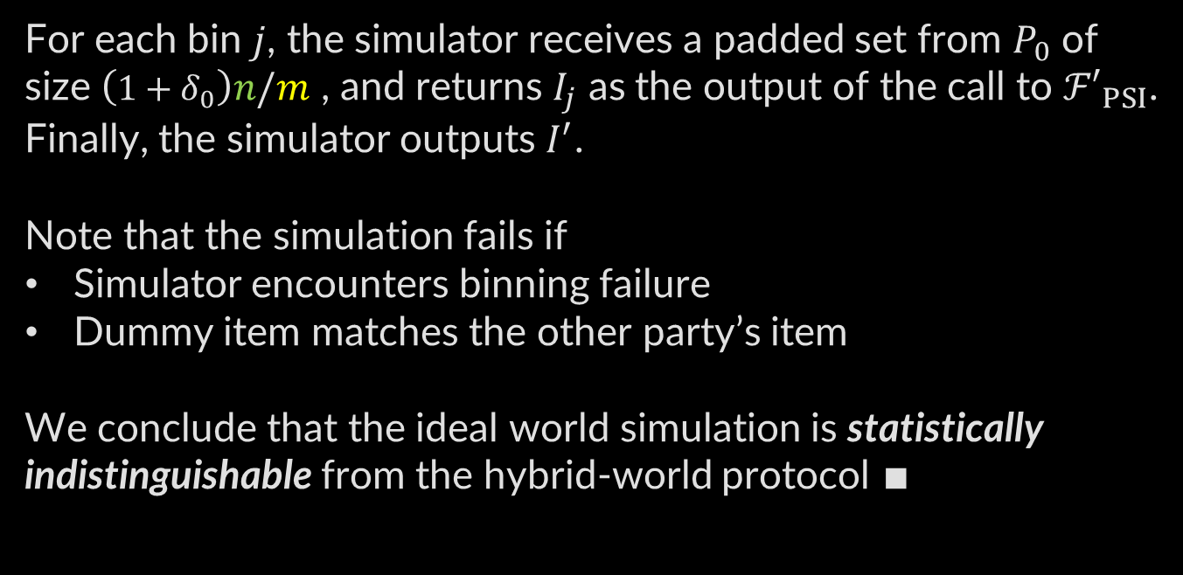
Simulation
Balanced Allocation
Cuckoo Hashing
Data Binning
For each bin $j$, the simulator receives a padded set from $P_{0}$ of size $\left(1+δ_{0}\right)n/m$ , and returns $I_{j}$ as the output of the call to ${ℱ′}_{PSI}$.
Finally, the simulator outputs $I^{′}$.
Note that the simulation fails if
Simulator encounters binning failure
Dummy item matches the other party’s item
We conclude that the ideal world simulation is statistically indistinguishable from the hybrid-world protocol $∎$

Slide 76
Thanks For
Listening

